Slide 1
Falls & Fractures: Awareness and Prevention
Rachel Clifford / Sue Ducker
NHS Arden Commissioning Support

Slide 2
Learning Outcomes
Awareness and consequences of falls
Identify risk factors and interventions
Awareness of dementia / osteoporosis and falls
Awareness of other medical conditions
Identify actions for your care home
Notes:
At the end I would like it if you would put on your feedback form any ideas you have learnt from today that can be used with your residents or in your home.

Slide 3
Falls Quiz
What percentage of fatal accidents in people over 65 is due to a fall?
25% □ 55% □ 71% □
2. What percentage of hospital admissions from care homes
follow a fall?
20% □ 40% □ 60% □
3. 60% of all hip fractures are due to falls T / F
4. Researchers have established over 400 different risk factors
that can cause a fall T / F
Notes:
71%
40%
False – 95%
True

Slide 4
Falls Quiz
5. Older people living in care homes are three times more
likely to fall than older people living in the community T / F
6. Which of these should be recorded as a fall?
a) resident lost her balance and was lowered to the floor by staff
b) resident was unable to get back up after kneeling on the floor
c) resident was found on the floor but the means by which he got
to the floor was un-witnessed
d) resident rolled off a mattress that was on the floor
Notes:
True
A) Fall
B) No
C) Record as fall, unless resident tells you they got on the floor deliberately
D) Fall

Slide 5
Definition of a Fall
‘A sudden, unintentional change in position causing an individual to land at a lower level, on an object, the floor, the ground or other surface’. (Tinetti 1997)
This includes: slips, trips, falling into other people, being lowered, loss of balance, and legs giving way.
Notes:
Emphasise unintentional.
Staff lowering patients to the floor also counts towards a fall, even if the patient does not sustain any injuries, because it is unintentional.

Slide 6
Prevalence of Falls in Care Homes
In care homes falls account for around 90% of reportable injuries to residents
70.000 hip fractures in England and Wales each year
20% from care homes
1 in 3 care home residents will die within 6 months following hip fracture
Very high risk of falling in first two weeks for new admissions
Notes:
A high percentage of hip fractures occur in care home residents and the outlook within 6 months is worse due to poor physical and mental well-being ie more frail, less muscle strength. Memory loss and confusion mean that residents find difficulty following post-op instructions or exercise programmes.

Slide 7
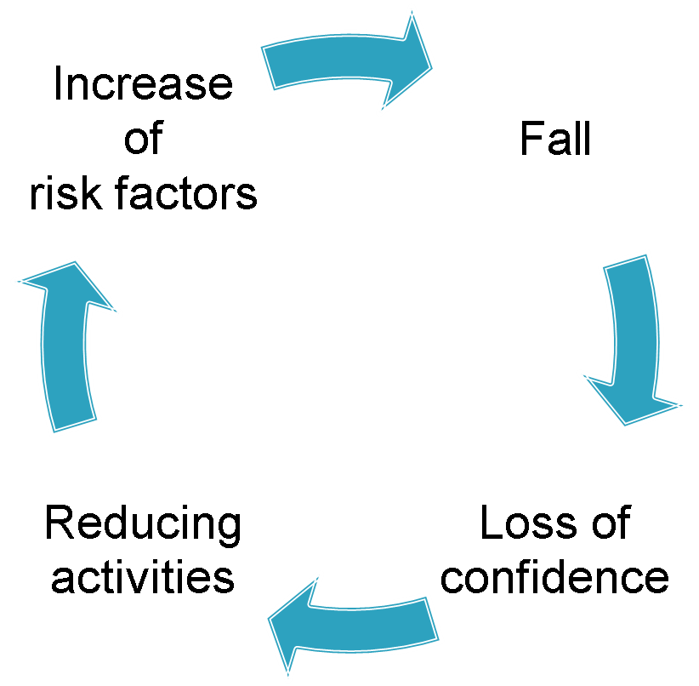
Consequence of Falls
Notes:
Loss of confidence / fear of falling - significant increase:
- after recent fall
- fall with injury
- unable to get off the floor
Reducing activities:
More time seated
Less out in community
Less ADL
Increase of risk factors:
Reduced strength, balance, flexibility
Depression
Isolation
Relatives may feel more anxious/concerned
Staff may need to spend more time with the resident/relatives to reassure them. More time spent on care delivery if patient less mobile, reduced confidence etc
May adopt shuffling gait or overreach to grab for furniture or try to sit down before in front of a chair
FEAR 0F FALLING AND LACK OF CONFIDENCE PREDICT:
Deterioration in physical function, and activity, increase in fractures and admission to a care home

Slide 8
Consequences of Falls for Staff
Diverting staff from planned care
Increased workload
Extra paperwork
Complaints
Notes:
Diverting – post fall staff have to deal with the aftermath – look after resident, perhaps phone ambulance, inform relatives, more regular checks
Workload – more time with the resident, reassurance, supervision or assistance with ADL’s, mobility. Need to rebuild confidence
Paperwork – accident/incident forms, review falls risk assessment/care plan,
Complaints – managers have to deal with relatives complaints

Slide 9
Falls Assessment
Key points in a resident’s journey of care
Pre-admission to the care home
Admission to the care home
At any point when a resident’s needs change
After a fall
After a change in medication
On transfer from another care setting
At routine review of care plans/risk assessments
Notes:
The key points are specific times when residents falls risk needs to be reviewed/monitored
NEEDS CHANGE – eg less mobile due to OA or deterioration in a chronic condition such as PD or dementia
AFTER A FALL – loss of confidence, change in physical condition, increased needs. R/v when/how/where fall happened
CHANGE IN MEDICATION - many meds have side effects such as drowsiness, fatigue, dizziness, change in behaviour, needing to get to toilet quickly
TRANSFER FROM ANOTHER CARE SETTING – higher risk of falls (new to home), abilities may be different to what home have been told, possible deterioration after hospital admission
ROUTINE REVIEW OF CARE PLANS/RISK ASSESSMENTS – should be monthly

Slide 10
Falls Assessment
Pre-admission to the care home
Past history of falls and fractures
Current strategies for managing risk of falls
Osteoporosis risk
Mobility aids / specialist equipment to be in place prior to admission e.g. raised toilet seat, low-profiling bed, appropriate seating
Notes:
If there is a history of falls/fractures this increases risk of recurrence. People tend to fracture wrist first as quicker saving reactions, but when more frail this increases chance of fracturing hip as they cannot react quickly enough to put hands out to save themselves.
Current strategies – eg do they get up several times a night, are they safe using toilet on their own, talk to family/nursing staff
Osteoporosis- signs to look for – height loss, curvature of spine, frail

Slide 11
Falls Assessment
Admission to the care home
Multifactorial falls assessment: identify risk factors that could lead to falls
Using scored risk assessments: Gives false assurance something has been done. Two residents with same score may be at risk for very different reasons
Notes:
National guidelines – NICE say the falls risk assessment must be multifactorial as evidence is that single interventions are not effective at reducing falls.
Lead into what potential risk factors could be
Assessing and modifying the person specific risk factors can reduce falls by 50-60%.
Give example of what should be in a good falls risk assessment
Lead into what potential risk factors could be
Give example of what should be in a good falls risk assessment

Slide 12
Falls Risk Factors
Factors associated with the individual resident
Factors associated with the environment
Factors associated with the care delivery

Slide 13
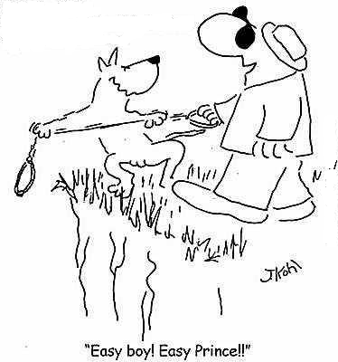
Falls Risk Factors
Factors associated with the individual resident
Notes:
Get participants to shout out ideas

Slide 14
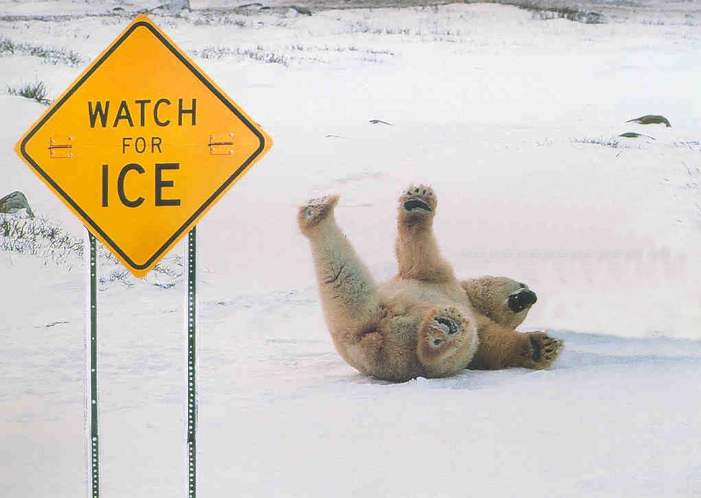
Falls Risk Factors
Factors associated with the environment
Notes:
Get participants to shout out ideas

Slide 15
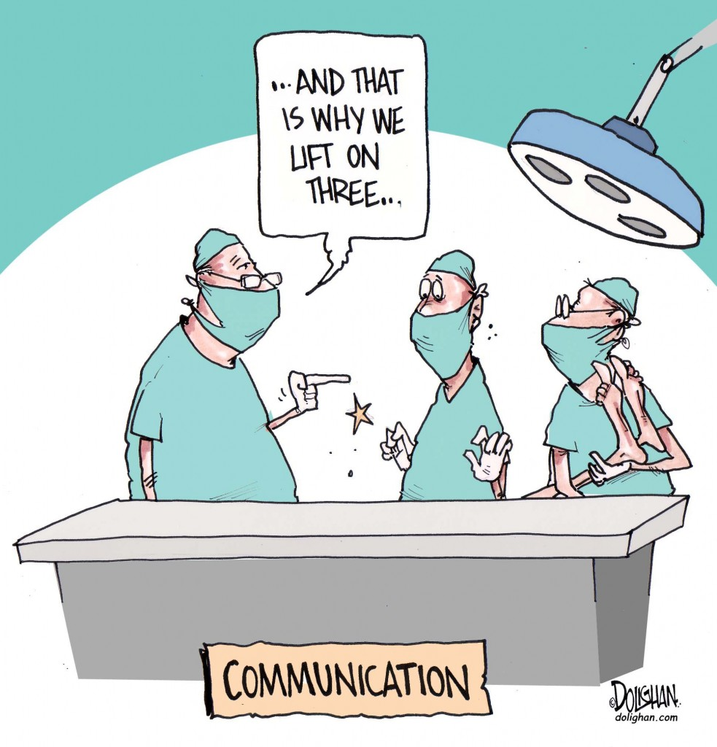
Falls Risk Factors
Factors associated with the care delivery
Notes:
Get participants to shout out ideas

Slide 16
Reducing Risks
Can we change or manage the risks?
Modifiable
Low muscle strength
Poor balance
Fear of falling
Clutter
Non-modifiable / manage
Age
Dementia
New admission
Stairs
Notes:
Mention involving family e.g. slippers

Slide 17
Manage or modify Individual Falls Risk?
Gait/balance
Muscle strength
Dizziness
Vision
Hearing
Feet / footwear
Notes:
MUSCLE WEAKNESS/BALANCE/GAIT – possible to modify in certain individuals. Calcium/Vit D has been shown to improve body sway and muscle function in elderly. Most residents benefit from regular walks, standing activities to maintain strength, balance.
Chair exercises – improve strength, power, functional ability, flexibility, confidence. Exercise needs to be tailored and specific so better 1:1 or small groups (partic for dementia)
DIZZINESS – may need investigation, check lying/standing BP. Manage hypotension with compression stockings, Fludrocortisone, resident taking their time
VISION – manage through yearly eye checks with optician – most common eye conditions AMD, cataracts, glaucoma, well lit areas for reading, good general lighting
HEARING – induction loop system (communal areas), good lighting and quiet areas without TV’s, don’t avoid conversation
FEET/FOOTWEAR – manage foot problems with regular chiropodist. Reduced ROM in ankle/feet can increase risk. Footwear – wellfitting, supportive shoes or slippers if not

Slide 18
Manage or modify Individual Falls Risk?
Medication
Reduced memory/cognition
Poor nutrition or hydration
Continence
Notes:
MEDICATION – can be modified. Increased risk if on 4 or more meds. Types of meds that are high risk: sedatives, anti-psychotic, anti-depressants, anti-hypertensives, diuretics.
COGNITION/MEMORY – manage cognition. Can modify other two – may be clues why they are agitated – talk to family,gain insight into the resident
NUTRITION/HYDRATION – can be modified. Have they lost weight unintentionally ?need referral to dietician or GP
CONTINENCE ?toileting routine, night lighting, adequate hydration, ?refer to Continence Team

Slide 19
Manage / modify Environmental Falls Risk?
Clutter
Flooring – rugs / slippery / uneven etc
Steps / stairs
Lighting
Signage
Pets
Weather

Slide 20
Manage / modify Care Delivery Falls Risk?
Communication
Experience
Knowledge
’know your resident’
Staffing levels – day and night
Using equipment correctly

Slide 21
Safety Precautions
Ensure residents have access to assistance e.g. call bell
Ensure glasses are clean and within reach
Ensure use of appropriate footwear / clothing
Ensure mobility aids are in reach
Ensure the resident’s chair is suitable
Ensure the bed is at a appropriate level
Ensure the environment is free of hazards
Regular medication reviews
Notes:
Glasses – mention varifocals
Mobility aids – regularly maintained, W/C check and check ferrules
Bed height – low at night time if tendency to fall out of bed. If someone that likes to get up at night, not too low
Footwear/clothing – not bare feet due to potential broken skin, clothes not dragging on floor

Slide 22
Falls Care Plan
Identify falls risk factors / care needs
History of falling
Balance/mobility
Medication
Dizziness
Nutrition
Cognitive impairment
Continence
Feet/footwear
Vision
All identified risk factors should lead to an intervention / care plan
Notes:
History of falling – eg requires prompting to use frame. Supervision with mobility
Balance/mobility – ensure grab rails in bathroom, call bell in reach
Meds – are they on 4 or more, note side effects, inform GP, ensure reviewed 6 monthly. If on diuretics ensure easy access to toilet and regular toileting
Dizziness – lying standing BP, prompting with slow, careful movement
Nutrition – has the resident lost weight unintentionally – refer to GP/dietician
Cognitive impairment – are they confused, disorientated, ensure environment clutter free, signage etc, falls prevention equipment, routines with
adls, etc ; including ability to use call bell
Continence – does this contribute to falls. Instigate toileting routine, continence assessment/chart
Feet/footwear – exercise, refer to podiatry, shoes
Other common risk factors:
Medical conditions eg stroke, parkinsons, arthritis; bone health assessment; hearing; ADL nee
ds – dexterity to use call bell;
Use example of a care plan / resident

Slide 23
Post Fall Protocol
Immediate response
Basic life support
Check for injuries
Baseline observations
Make safe any environmental hazards
Monitor the resident
Review Falls Assessment and Care Plan
Inform relevant contacts
Incident reporting
Record the circumstances – to analyse and learn
Notes:
ASK IF THEY USE PROTOCOLS – IF YES DO THEY HAVE A POST FALL PROTOCOL IF NO TALK ABOUT IMPORTANCE – RESIDENT SAFETY, SAFE M AND H, LEARNING FROM INCIDENTS
? Take an example post-fall protocol
Check if patient is responsive
Check airways, breathing and circulation
Check for injuries
If no apparent injury – assist patient to bed or chair
If head trauma and or fracture are apparent or suspected:
on wards: notify doctor and senior nurse
community: transfer to A&E
do not move patient if suspected lower limb or spinal fracture – make patient comfortable on floor
suspected upper limb fracture – immobilise limb, transfer to bed or chair
Baseline observations
Check for any symptoms of nausea, confusion, drowsiness, agitation
hospital: pulse, blood pressure, temperature, oxygen saturation
Make safe environment
Remove or minimise environmental hazards that contributed to the fall
if hazards can’t be removed ensure necessary warning is implemented
Monitor patient (hospital)
Head trauma: neurological observations based on NICE Clinical Guidance
community: instruct patient to visit A&E, phone GP, NHS direct
Involve resident / family – can they give an account eg why were they getting out of bed why didn’t they use call bell etc

Slide 24
History of the Fall
How, where, why, when
Isolated incident or is there a pattern?
Monthly falls audit
Measles chart
Notes:
Important to establish the facts in order to prevent it happening again or minimise risk.
Can establish patterns using monthly audit which highlight time of day, room for individuals and also for the home as a whole (eg member of staff permanently in lounge)
Talk about measles chart (in scottish document)

Slide 25
Dementia and Falls
40 – 70% of dementia sufferers will fall each year
Outlook is worse than non dementia sufferers:
Less likely to make a satisfactory recovery from injury
Five times more likely to be admitted to a care home
71% die within 6 months after a hip fracture
Notes:
Dementia significantly increases the risk of falling
Serious injury is more common: 25% will sustain a fracture

Slide 26
Dementia and Falls
Why do residents with dementia fall?
Medication
Walking pattern and balance problems/walking aids
Visual/perceptual problems
Wandering / exhaustion in agitated resident
Mini strokes
Safety awareness
Communication problems
Environment
Over or under stimulation
Notes:
Also malnutrition, incontinence, confusion, boredom, pain
Environmental – e.g. visual prompts – walking aids and toilets – night light sensors?
VISUAL DIFFICULTIES – may have healthy eyes but have visual difficulties caused by the brain ie Lewy Body, vascular dementia, Alzheimers

Slide 27
Dementia and Falls
How to prevent falls in residents with dementia?
Successful interventions include:
Multi-disciplinary approach
Involve family – know the resident
Identification of each specific risk factor
Activities/distraction
Minimisation of environmental hazards
Use primary colours in environment; Red, yellow, blue
Modification of medication
Notes:
Who is the person with dementia. Is there any pattern to the falls e.g. time of day

Slide 28
Dementia and Falls
www.kingsfund.org.uk
Search: EHE environmental assessment tool
Notes:
Have a copy available to show and the website on a handout?

Slide 29
Osteoporosis and Falls
Osteoporosis means porous bones
It affects 1 in 2 women and 1 in 5 men over 50
Osteoporosis does not cause falls but if you have it the consequences are more severe
No standing activity leads to loss of bone and muscle
Notes:
50% of people who live independently before a hip fracture are unable to do so afterwards
5-10% of people die within a month of a hip fracture
20-30% die within one year
50% of people who live independently before a hip fracture are unable to do so afterwards
5-10% of people die within a month of a hip fracture
20-30% die within one year

Slide 30
Osteoporosis and Falls
Notes:
**participation – why is it relevant to falls prevention / what do they know about disease, who could be at risk??
Osteoporosis occurs when the holes become bigger and the bony connections become thinner
Bones become fragile and break more easily
Fracture areas: wrist, hip, spine
Risk factors include – low body weight (poor nutrition / calcium), age, previous fracture, heavy smokers/drinkers, lack of sunlight / Vit D

Slide 31
Osteoporosis and Falls
Treatment
Medication
Calcium & Vitamin D
Weight bearing exercise
Healthy eating
Healthy lifestyle
Hip protectors

Slide 32
UTI’s
More common in the elderly
Can greatly increase risk of falls
How can you –
Prevent UTIs?
Identify UTIs?
Treat UTIs?
Notes:
UTI’s are more common in older people because of retention (bacteria grow), dehydration (urine is very concentrated leading to irritation), bowel incontinence, diabetes (lowers resistance), prostate problems etc. Can lead to lots of issues including falls. Falls often co-incide with UTI.

Slide 33
UTIs
Prevention – changing pads often, push fluids, front to back cleaning, avoid caffeine, cotton underwear
Identify UTI – frequency/urgency, cloudy /strong smelling urine, pain/burning sensation, change in behaviours or mobility
Treat promptly and re-test if indicated, involve continence team / GP?
Notes:
Highest risk for Res with incontinence as pads can introduce bacteria to bladder. Therefore change pads often. If Res develops UTI – early diagnosis and treatment to clear infection very important – No delays in getting antibiotics. Also re-test sometimes needed if sypmtoms continue. Involve GP or continence if ongoing issue (Continence can scan bladder to see if there is retention). GP could consider maintenance anti-biotics?

Slide 34
Other important medical conditions
Infections
Blood pressure problems
Parkinson's Disease
Diabetes
Blackouts / collapses
Notes:
Participation – what infection may effect mobility? Chest/ UTI
High or low BP? What problems does it cause?
Postural Hypotension – drop in BP on standing – esp mornings take time etc
Diabetes – diabetic retinopathy rates in >65’s have doubled in last 25 years.
Blackout or collapse – common causes – heart / stroke /BP dropping low – this is medical and needs investigation

Slide 35
Case Study 1 - Fred
88 years old
Uses walking stick
Couple of falls in last year, but just had 4 falls in 2 days
What could be the cause?
What simple test can be done in the home?

Slide 36
Fred
Possible UTI as sudden increase in falls – dip stick urine to check
Is blood pressure ok?

Slide 37
Case Study 2
Age 92, history of falls previously
Poor mobility, needs to use a zimmer
New to the home
Dementia, disorientated, anxious, forgets her frame
Trying to leave, constantly walking
Had a few falls during the day
What are her falls risk factors?
What can be done to reduce these?

Slide 38
Case Study 2
Risks – new resident, dementia (forgets frame, disorientated, anxious, poor insight), tiring due to constant walking
Reducing the risks – orientation, getting to know Mary, distraction, reassurance,
Medication should be a last resort as likely to settle in time

Slide 39
Case Study 3
Has Parkinsons Disease and dementia
Using a zimmer
Most falls happening in bedroom
Forgets to use call bell
What can be put in place to reduce Harrys falls?

Slide 40
Harry
Sensors
Regular checks
Equipment to help Harry transfer
Where is room in relation to staff
Is his BP okay?
?low bed / crash mat?
Lighting , room layout etc

Slide 41
Further support
Social care and social work improvement Scotland
Managing falls and fractures in care homes for older people:
www.scswis.com
A toolkit to encourage activities in care homes:
www.tinyrul.com/COT-Living-Well
Notes:
Give a little more info about this? Examples of what to include for post fall protocols etc

Slide 42
Any questions

